Slide 1
Route to 2045 Charlotte County-Punta Gorda MPO LRTP
MPO Board
October 5, 2020

Slide 2
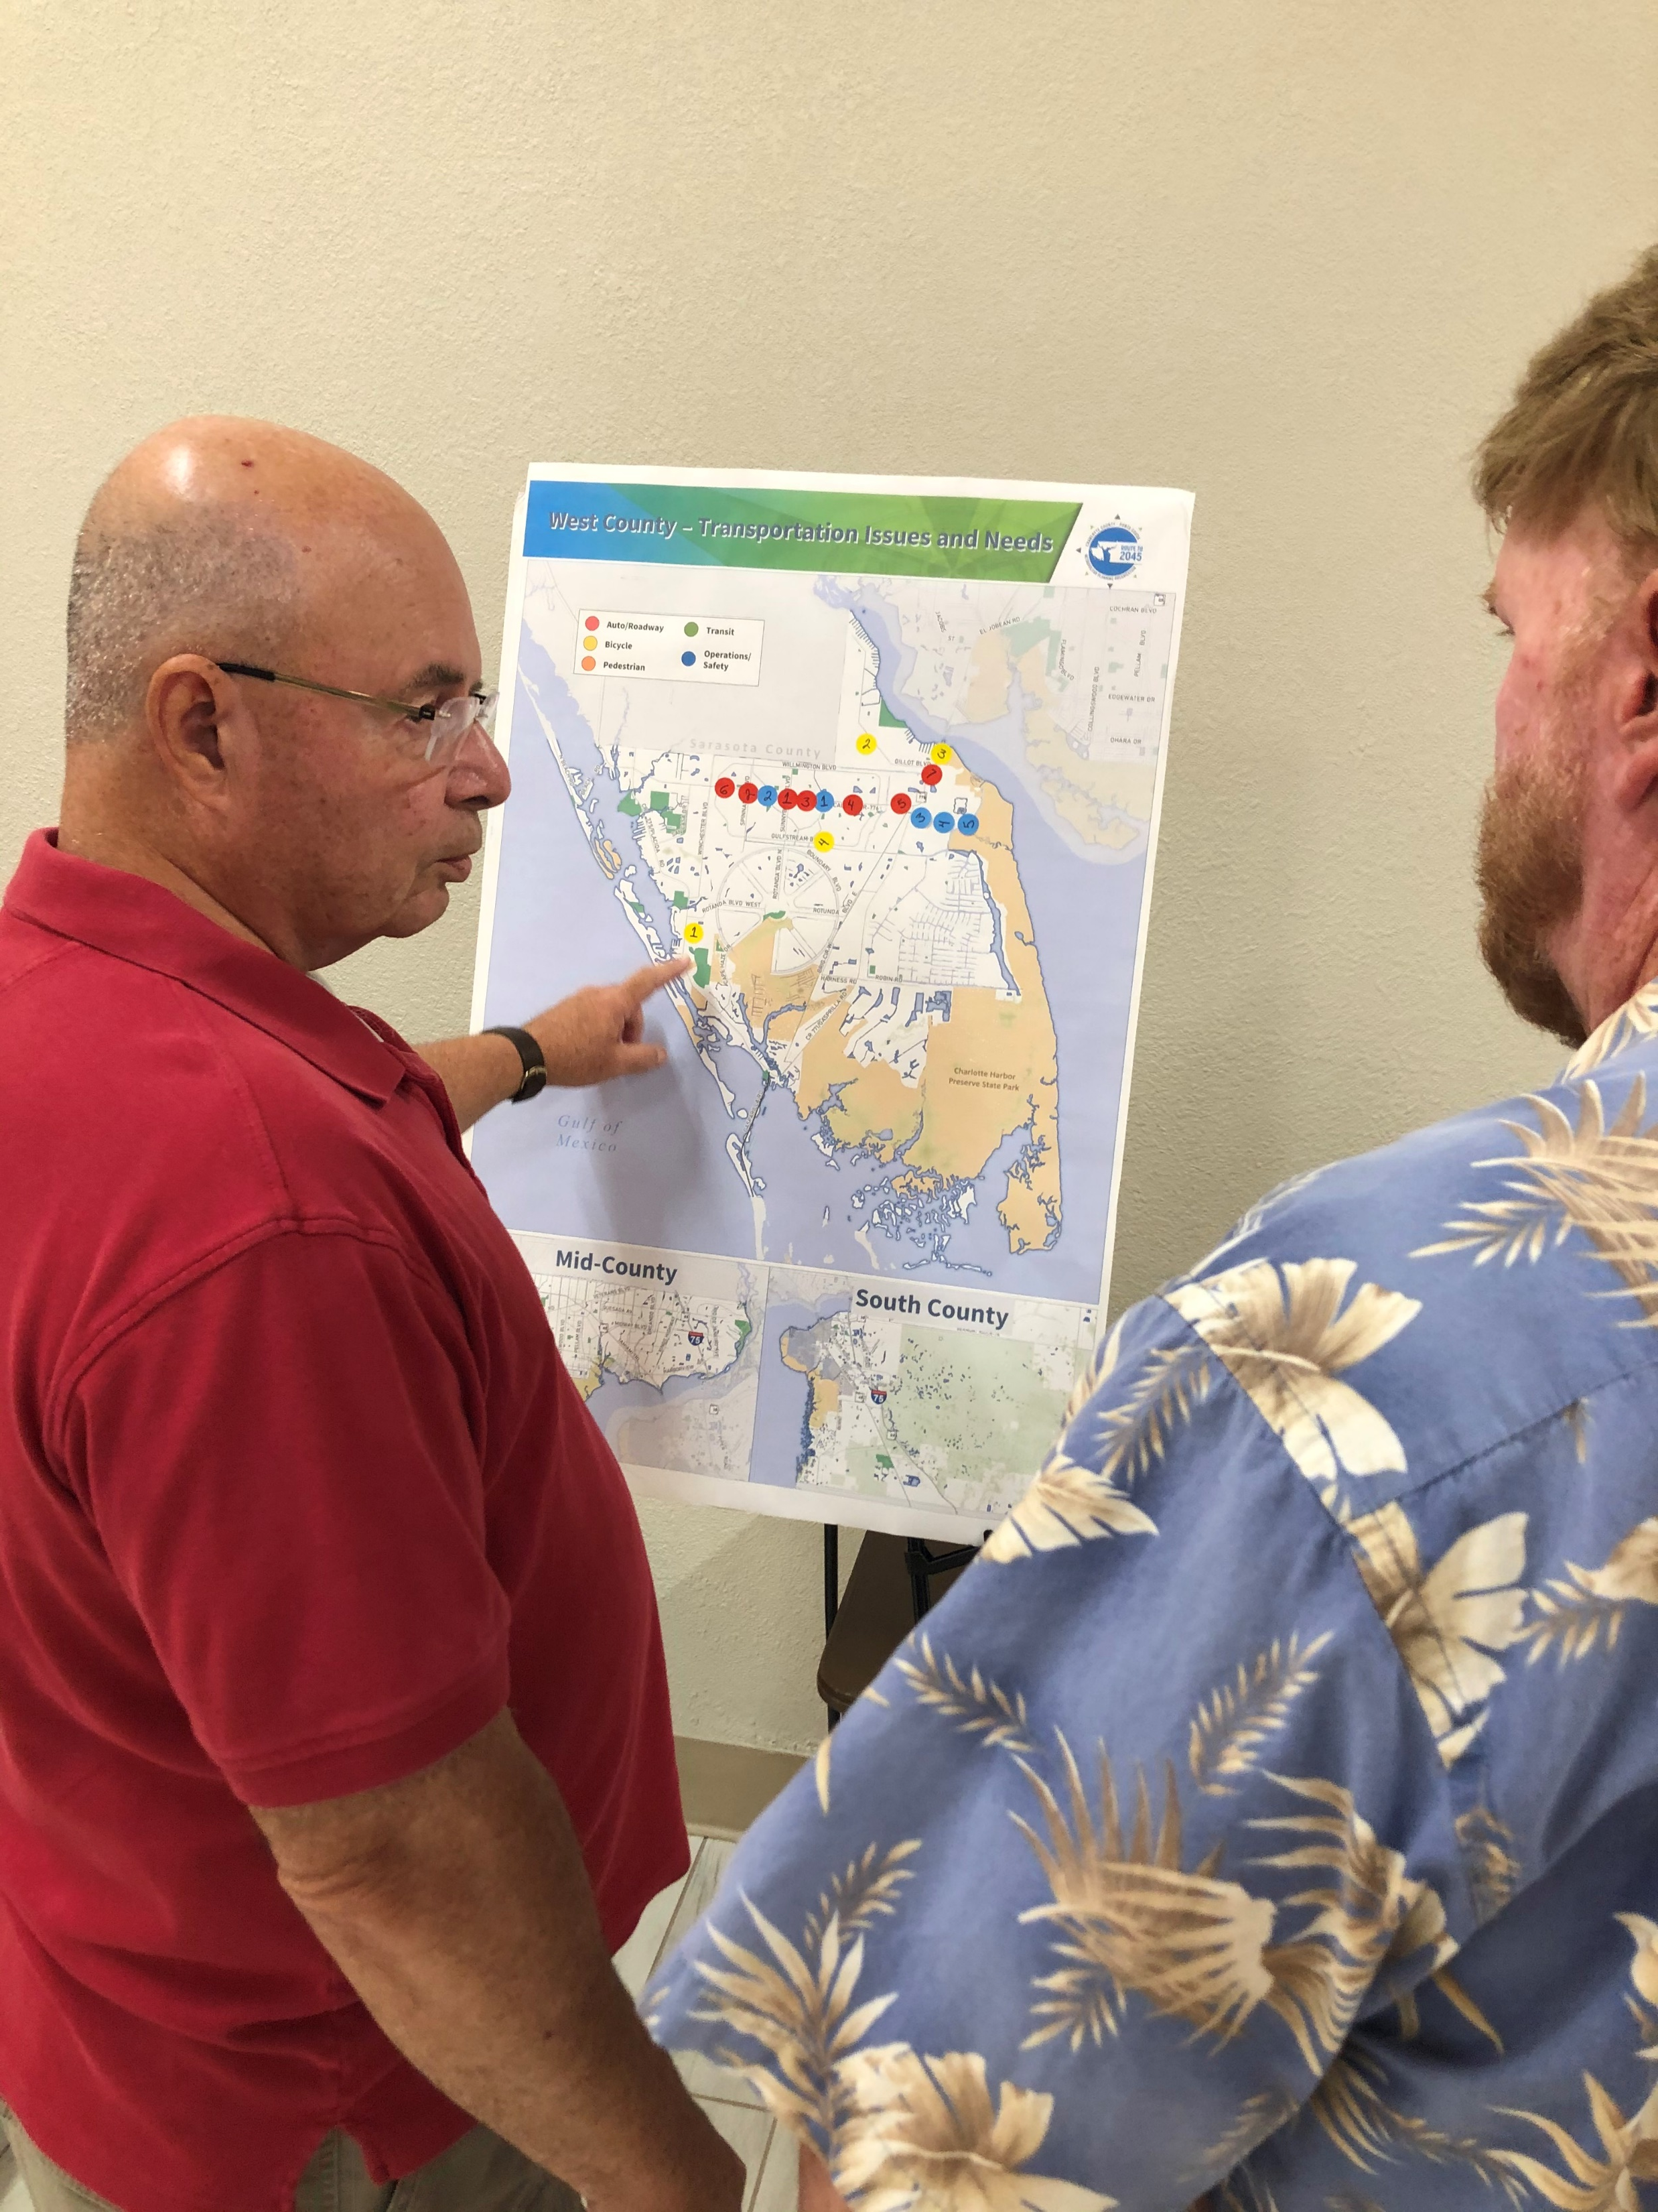
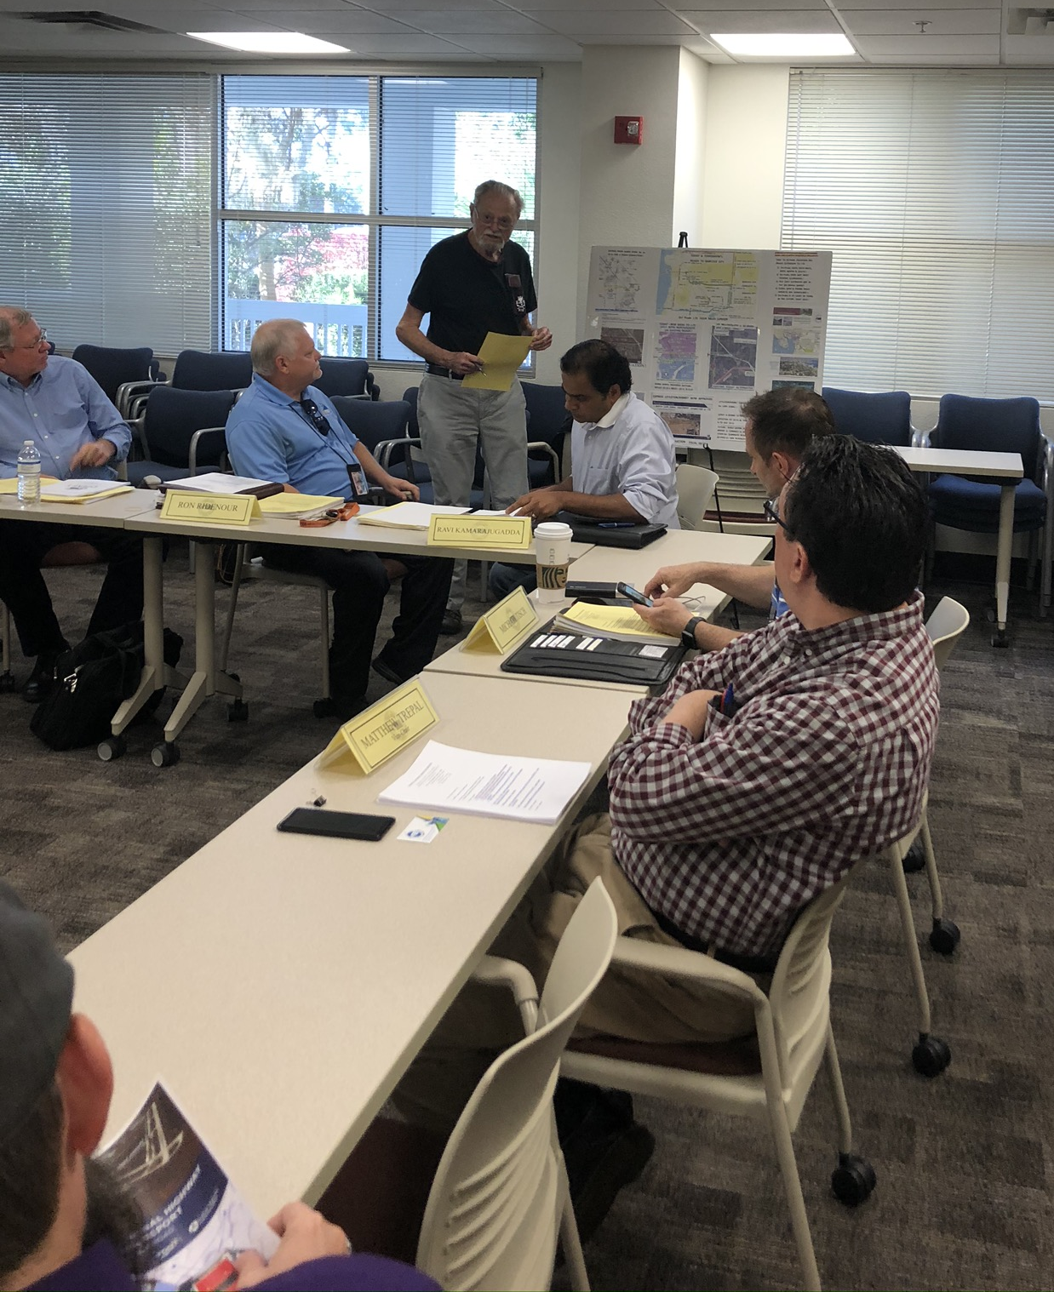
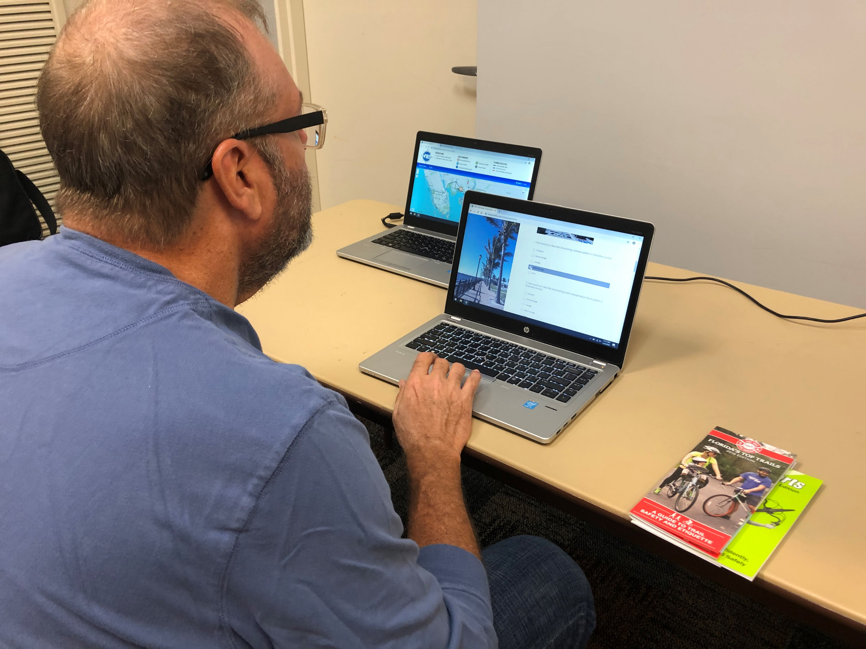
Route to 2045 Adoption
LRTP Development and Approval Process
Outreach and Public Involvement
Revisions to Draft Cost Feasible
Next Steps

Slide 3
LRTP Approval Process
MPO updates the LRTP every five years.
Develop a vision along with goals & objectives
Assess the needs with input from local entities
Develop a draft Cost-Feasible Plan
Review draft plan with FDOT and local partners
Provide opportunity to comment on the draft plan
MPO adopts final plan

Slide 4
LRTP Development
Meet Federal Planning Requirements
Updated every 5 years
Develop Cost Feasible Plan
Minimum 20-year planning horizon
Created with public input
Implemented by State & Local Agencies through the Transportation Improvement Program

Slide 5
Route to 2045 Vision
Provide an efficient and reliable multimodal transportation system that supports safe, resilient and accessible transportation choices that enhance the quality of life for all who live, visit, work, and play in the County.
Goal 1 - Efficient Travel
Goal 2 - Transportation Choices
Goal 3 - Natural Spaces
Goal 4 - Vibrant Centers
Goal 5 - Safety and Security

Slide 6
Bicycle/Pedestrian Needs

Slide 7
Bicycle/Pedestrian Needs
Brought forward Needs from 2040 LRTP
Includes all roadway widenings in 2045 Needs
Consistent with Bicycle/Pedestrian Master Plan
Revised description of Taylor Road Bike Lane
Royal Road to Airport Road

Slide 8
Charlotte County Transit Development Plan Needs

Slide 9
Transit Needs
Consistent with Transit Development Plan
Enhanced Dial-a-Ride & Charlotte Link
Along US 41 Corridor
Englewood (SR 776 / Englewood Library)
Punta Gorda
US 41/Airport Connector Route
Express service to Englewood & Beach Circulator
Peak hour express service to Babcock Ranch
Infrastructure and Technology improvements

Slide 10
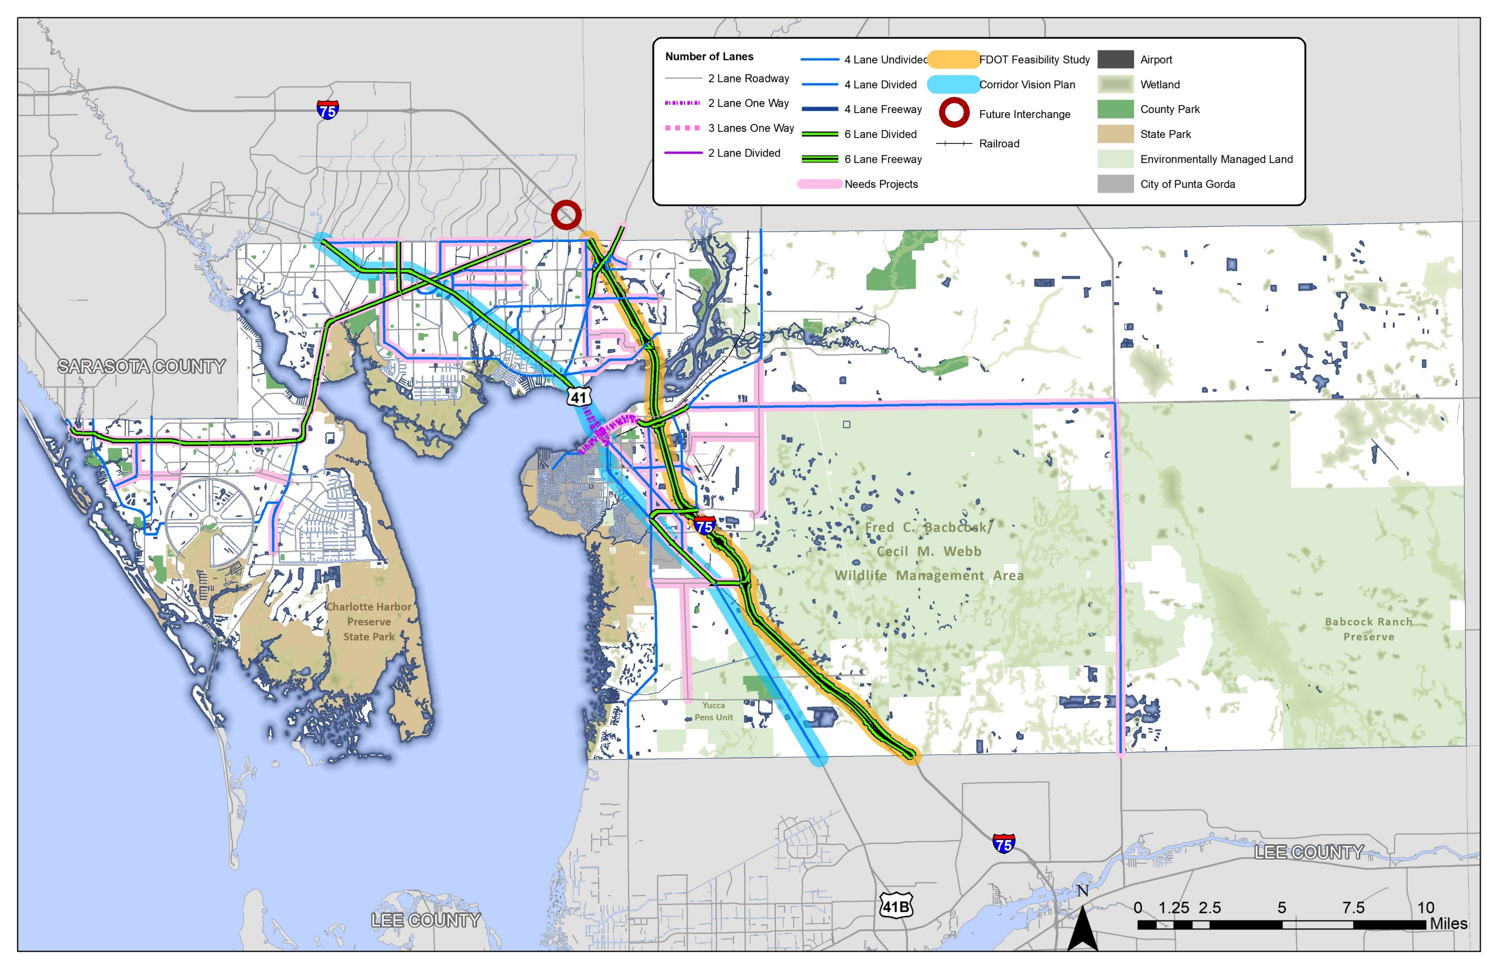
2045 Roadway Needs Projects

Slide 11
Roadway Needs
Based on projections of future growth
Evaluated future travel demand in coordination with FDOT and neighbor MPO’s
Tested effects of Connected Autonomous Vehicles on congestion
Incorporated intersection improvement needs

Slide 12
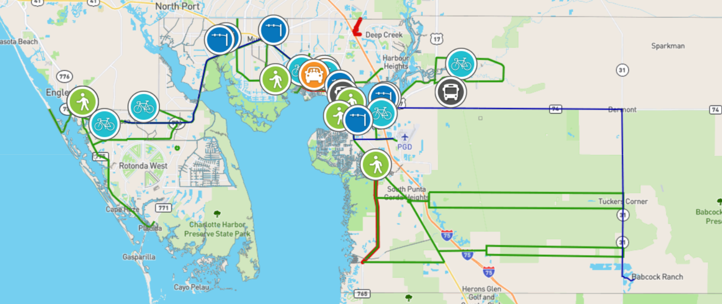
Public Outreach for Developing Route to 2045 LRTP
Newsletter provided information on LRTP
Project Cards
Two online Surveys
Interactive Online Map of issues
In-Person Workshop in February
Virtual Workshops in June
30-Day Comment Period

Slide 13
2045 LRTP Revenues
Future Year $ in millions
Total Funds | 2026-2030 | 2031-2035 | 2036-2045 | Total
Bicycle/Pedestrian | $12.09 | $13.87 | $34.09 | $60.05
Transit | $22.88 | $26.36 | $65.41 | $114.66
Roadways | $173.21 | $218.03 | $460.32 | $851.57
Maintenance | $47.46 | $48.42 | $98.41 | $194.28
Total | $255.64 | $306.68 | $658.23 | $1,220.55

Slide 14
Cost Feasible Bicycle / Pedestrian Projects
Bicycle/Pedestrian Master Plan
SunTrail Network
US 41 Corridor Vision Plan
Lee County to Burnt Store (Tier 1)
Peace River to Midway (Tier 1)
Midway to SR 776 (Tier 2)
Cape Haze Pioneer Trail Corridor
Opportunities to build with roadway projects
Harbor View Road (Tier 1)
Edgewater Drive (Tier 1)
Type | Existing Miles | Proposed Miles
Sidewalks | 393 | 17
Bikeways & Paved Shoulders | 93 | 54
Shared-Use Paths | 44 | 94
Total | 530 | 165

Slide 15
Cost Feasible Transit Projects
Consistent with Transit Development Plan
Enhanced Dial-a-Ride & Charlotte Link
Along US 41 Corridor
Englewood (SR 776 / Englewood Library)
Punta Gorda
US 41/Airport Connector Route
Express service to Englewood & Beach Circulator
Peak hour express service to Babcock Ranch
Infrastructure and Technology improvements

Slide 16
Cost Feasible Roadway Projects 2021 – 2025 (Transportation Improvement Program)
Burnt Store Road – Zemel Rd to Scham Rd
SR 776 @ Flamingo Blvd intersection
Partially funded
Jones Loop Road: Burnt Store Rd to Piper Rd
SR 776: CR 775 (Placida) to Spinnaker
Harbor View Road: Melbourne St to I-75
US 17 (Marion Ave/Olympia Ave): US 41 to Marlympia
SR 31 @ CR 74 roundabout
SR 776 @ Charlotte Sports Park intersection

Slide 17
Cost Feasible Roadway Projects 2026 – 2030
Existing Priorities
Harbor View Road
US 17 Complete Streets
Edgewater Drive Phases 3-5
SR 776 @ Charlotte Sports Park
SR 31 @ CR 74

Slide 18
Cost Feasible Roadway Projects 2026 – 2030 (continued)
Additional Projects
SR 776 @ Gulfstream Blvd/Wilmington intersection
SR 776 @ Biscayne Blvd intersection
Toledo Blade from SR 776 to US 41
SR 776 Corridor Study (future intersection improvements) Englewood to Murdock
SR 31 from Lee County to Lake Babcock Drive
US 41 Corridor Vision Plan funding
ITS Master Plan Implementation

Slide 19
Cost Feasible Roadway Projects 2031 – 2035
Flamingo Blvd. from SR 776 to US 41
Harbor Blvd Extension from Veterans to Hillsborough
SR 776 from CR 775 (Placida) to Spinnaker
SR 776 @ Cornelius intersection
Taylor Rd. US 41 to N. Jones Loop
ITS Master Plan implementation

Slide 20
Roadway Projects 2036 – 2045
Burnt Store Rd from N. Jones Loop to Taylor
Prineville Dr from Paulson to Hillsborough
SR 776 intersection improvements
Taylor Rd from N. Jones Loop to Airport Road
Taylor Road from Airport Road to US 41*
US 41 @ Easy St.
US 41 @ Forrest Nelson
SR 776 @ Jacobs St
US 41 @ Carousel Plaza
ITS Master Plan implementation
* Request from Punta Gorda to remove project

Slide 21
Partially Funded Roadway Projects
Airport Road from Taylor Rd to Piper
Through ROW 2031-2035
Burnt Store Rd Extension from Taylor to US 17
Through PE 2036-2045
US 17 from Copley Ave to CR 74 (SIS)
Through PE 2036-2045
Existing I-75 interchanges
Through PE 2031-2035
Veterans/Peachland/Kings
Study/PE added for 2026-2030

Slide 22
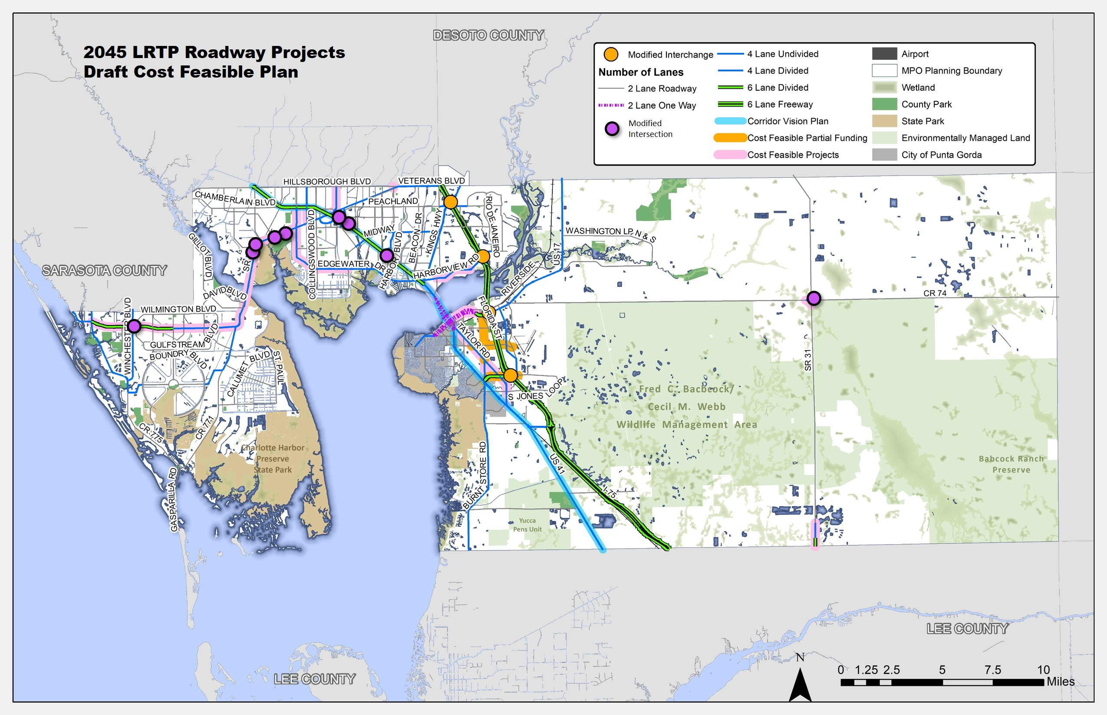

Slide 23
Schedule and Next Steps
September
Committee recommended approval of the LRTP
October
Public Comments received through MPO adoption
Present final LRTP to MPO Board for approval
Post-Adoption
Finalize full documentation (90-days)
Submit for Review by FDOT and FHWA
Fund future projects through annual Transportation Improvement Program adoption
October 5, 2020
LRTP Adoption

Slide 24
30-Day Comment Period
Review of 2040 and 2035 LRTP Needs
Bicycle/Pedestrian Needs
Taylor Road Trail limits
Support for intersection/operational projects on SR 776

Slide 25
30-Day Comment Period
Sarasota/Manatee MPO
Coordination on connection with Hillsborough Blvd, Raintree Blvd and Veterans Blvd
New interchange in South Sarasota County
FDOT
Clarification on Strategic Intermodal System Projects and timing
M-CORES description for LRTP report
Burnt Store Road Phase III includes 1200 feet in Charlotte County
Request from Punta Gorda to remove Taylor Road widening between Airport Road and US 41

Slide 26
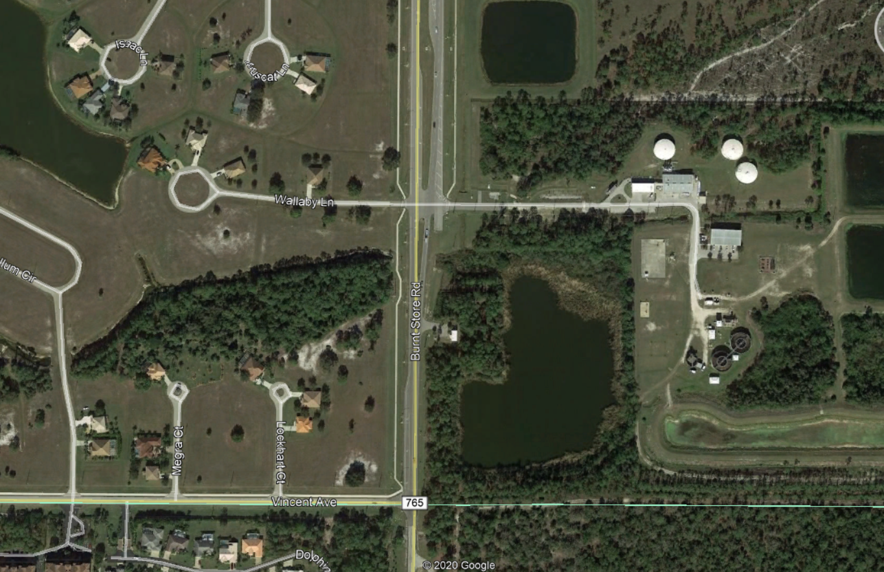
Burnt Store Road (Phase III)
Vincent Avenue and Wallaby Lane
1200 Foot segment
Existing 2-lanes
$2.54 million cost estimate (current year)
Available revenue in 2031-2035 time period
$3.11 million
Wallaby Lane
Charlotte County
Vincent Avenue
Lee County

Slide 27
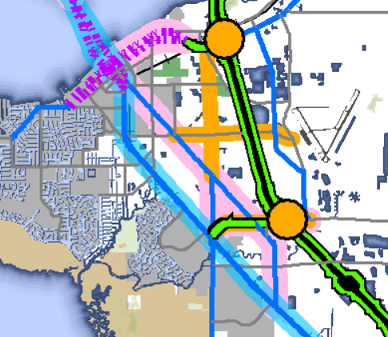
Taylor Road
Project #38: Airport Road to US 41 widen from 2 to 4 lanes (1.3 miles)
$22.98 million (current year)
$41.85 million (2036-2045)
City not supportive of widening
Inconsistent with historic neighborhoods
Impacts to adjacent city neighborhoods
Options for consideration
Designate as constrained roadway
Identify Complete Streets improvements
$14 million (current year)
Remove widening and list as future need

Slide 28
Today’s Action – Roll Call Vote
Adopt the “Route to 2045” Long Range Transportation Plan and authorize staff to modify Executive Summary Report based on comments received.

Slide 29
Route to 2045 Charlotte County-Punta Gorda MPO LRTP
MPO Board
October 5, 2020

