Slide 1
Route to 2045 Charlotte County-Punta Gorda MPO LRTP
May 18, 2020 MPO Board Meeting

Slide 2
Outline
Roadway Needs
Transit Needs
Bicycle/Pedestrian Master Plan
Project prioritization
Revenue Assumptions

Slide 3
Roadway Needs
Builds on the 2040 Needs and 2023 committed projects
Harborview Road Widening
Edgewater/Flamingo
Phases 3, 4, and 5
Connection between SR 776 and US 41
SR 776 and Veterans Blvd
Lane Reductions / Road Diet (US 17 and US 41)
Burnt Store Road Extension and Taylor Road Widening
Potential I-75 Interchanges / Modifications (FDOT Feasibility Study)
Coordination with neighboring MPOs

Slide 4
Roadway Needs
US 41 Community Vision Plan
Road Diet on US 41 from Kings Hwy to Peace River Bridge (4 lanes)
Road Diet on US 41 in City of Punta Gorda from Peace River Bridge to William St (2 lane one-way pair)
Lower Speeds – Punta Gorda, Murdock Circle area
Safety, Pedestrian Crossings, and Landscape

Slide 6
Transit Needs
Consistent with Transit Development Plan
Enhanced Dial-a-Ride & Charlotte Link
Along US 41 Corridor
Englewood (SR 776 / Englewood Library)
Punta Gorda
US 41/Airport Connector Route
Express service to Englewood & Beach Circulator
Peak hour express service to Babcock Ranch

Slide 8
Bicycle/Pedestrian Needs
Bicycle/Pedestrian Master Plan
SunTrail Network
US 41 Corridor Vision Plan
Lee County to Burnt Store (Tier 1)
Peace River to Midway (Tier 1)
Midway to SR 776 (Tier 2)
Cape Haze Pioneer Trail Corridor
Opportunities to build with roadway projects
Harbor View Road (Tier 1)
Edgewater Drive (Tier 1)
Type | Existing Miles | Proposed Miles
Sidewalks | 393 | 17
Bikeways & Paved Shoulders | 93 | 54
Shared-Use Paths | 44 | 94
Total | 530 | 165

Slide 9
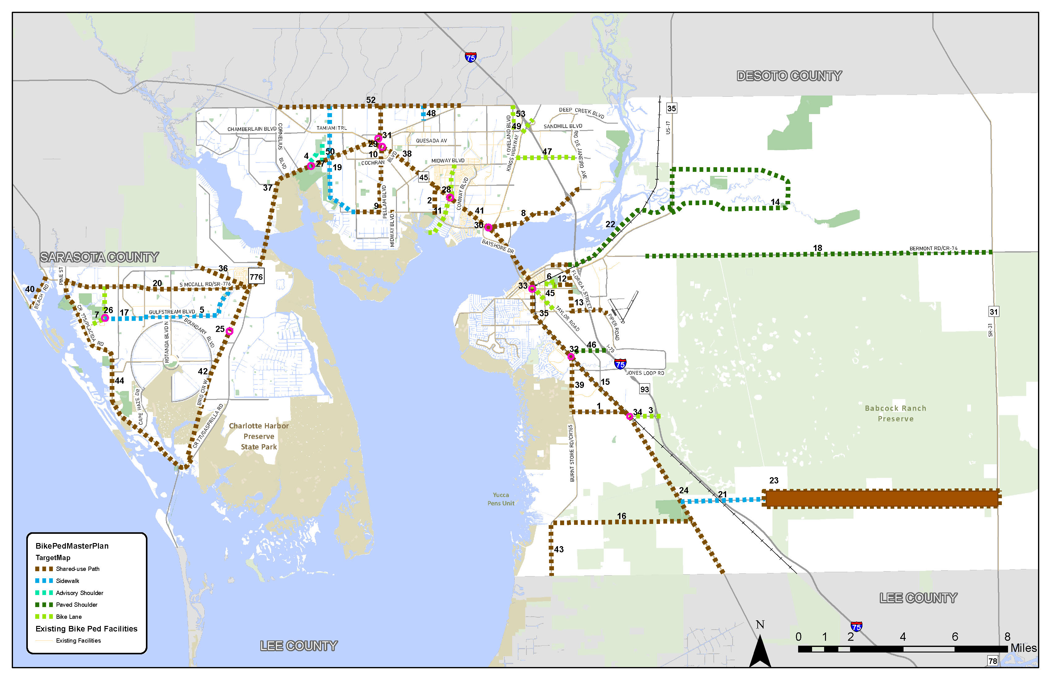

Slide 10
2045 LRTP Needs Costs ($ millions – 2019 Current Year)
Program | Estimated Cost
Roadway | $3,075.51
Transit (Capital) | $8.01
Transit (10-year operating) | $42.70
Bicycle/Pedestrian | $78.87
Total | $3,205.09

Slide 11
Prioritization Criteria
2045 LRTP Prioritization Criteria | 2045 LRTP Weight
Addresses Roadway Safety Hotspot | 20%
Multimodal Connectivity | 20%
Existing and Committed Volume to Capacity Ratio | 15%
Environmental & Community Impact | 10%
Roadway Significance and access to major activity centers | 10%
Emergency Evacuation Routes | 5%
Hazard Mitigation | 5%
Local Economic Development | 5%
Freight Access / Truck Route | 5%
Project Status | 5%

Slide 12
Prioritization Criteria
Prioritization Criteria | Goal 1 Efficient Travel | Goal 2 Transportation Choices | Goal 3 Natural Spaces | Goal 4 Vibrant Centers | Goal 5 Safety & Security
Existing and committed volume to capacity ratio
Community and environmental impact
Roadway safety
Access to major activity centers
Multimodal connectivity
Emergency evacuation routes
Hazard mitigation
Local economic development
Freight access
Project status

Slide 13
Federal / State Revenues (Millions – Future Year)
Funding Source | 2026-2030 | 2031-2035 | 2036-2045 | Total (2026-45)
Capacity Programs - Highway | $84.74 | $122.51 | $245.62 | $452.88
Transit (Federal/State) | $21.96 | $24.05 | $50.11 | $96.12
Transportation Alternatives (TA) | $2.50 | $2.50 | $5.01 | $10.01
Transportation Regional Incentive Program (TRIP) | $1.97 | $2.19 | $4.49 | $8.65
Fuel Taxes to Local Governments | $18.70 | $19.09 | $38.82 | $76.61
TOTAL | $129.88 | $170.35 | $344.05 | $644.28
2040 LRTP Federal / State Revenues = $524 million
23% Increase over 2040 LRTP

Slide 14
Existing Local Revenues (Millions – Future Year)
Funding Source | 2026-2030 | 2031-2035 | 2036-2045 | Total (2026-45)
Local Fuel Taxes | $60.39 | $61.61 | $125.19 | $247.19
Impact / Mobility Fees | $24.05 | $24.05 | $48.10 | $96.2
Local Government Sales Tax | $42.72 | $50.85 | $130.73 | $224.30
Local Transit Funding | $5.10 | $6.03 | $15.09 | $26.23
TOTAL | $132.27 | $142.54 | $319.12 | $593.92
2040 LRTP Local Revenues = $399 million
48% Increase over 2040 LRTP
Confirm Impact Fee and Sales Tax Assumptions
Fuel Taxes include vehicle efficiencies and declining usage

Slide 15
Cost and Revenue Comparison
Inflation factors provided by FDOT for estimating future year project costs
Future Year Revenues = $1,238 million
2019 Deflated Revenues = $751 million
Project cost estimates = $3,205 million
LRTP Implementation Year | Inflation Factor
2026 – 2030 | 1.341
2031 - 2035 | 1.577
2036 – 2045 | 1.855

Slide 16
Schedule and Next Steps
May
Local and Regional Coordination
Submitted list of projects for alternatives testing
Apply prioritization criteria
Develop initial list of cost feasible projects
June
Meet with LRTP Subcommittee to refine cost feasible projects
Prepare for virtual public meeting (June 15 – 26 tentatively)
July
Present draft Cost Feasible Plan to Committees and MPO
Begin 30-day public comment and review period.
October 5, 2020
LRTP Adoption

Slide 17
Route to 2045 Charlotte County-Punta Gorda MPO LRTP
May 18, 2020

Slide 18
